Slide 1

GESTURE-BASED
YOUTUBE CONTROLLER
www.reallygreatproject.com
ALP FINAL PRESENTATION

Slide 2

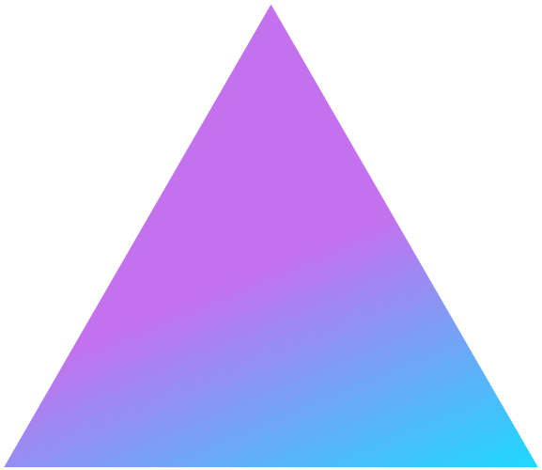
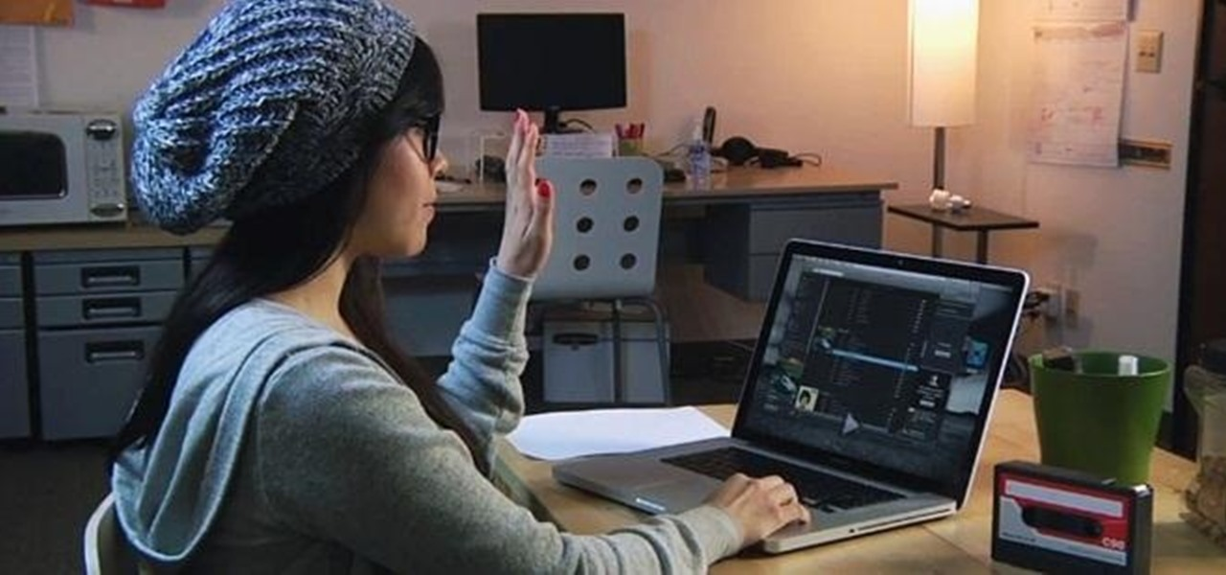
About the Project
This project depends on Convolutional neural networks (CNN), it detects the image and analyzes it to give out a certain output.
In this project, we implemented CNN so that it recognizes gestures to control videos.

Slide 3


LARANA COMPANY
Goals
FAST
ACCURATE
INTUITIVE
Detect hand gestures and convert them into computer inputs quickly.
Accurately detect the current gesture and perform the associated task.
Make the program intuitive and easy to understand for new users.

Slide 4
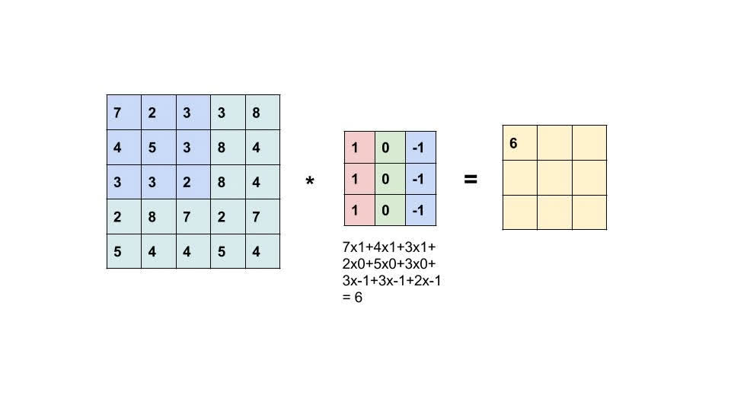

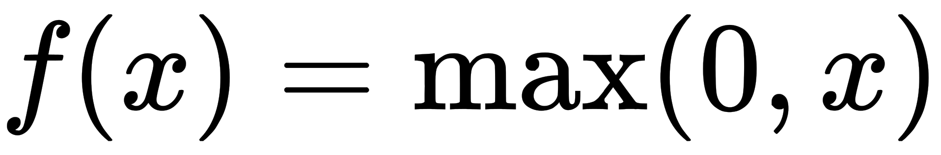
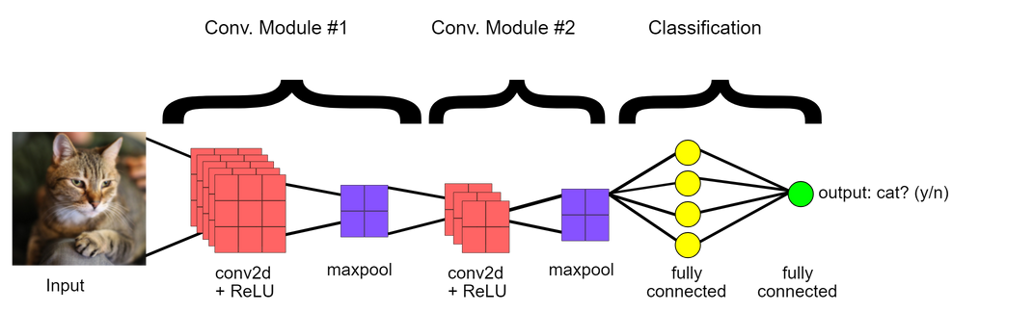
CONVOLUTIONAL NEURAL NETWORK
Convolutional Layer: A kernel runs over a group of pixels, multiplying each pixel of the kernel with a corresponding one in the image, and outputting the sum.
Pooling Layer: The most common is max pooling, which partitions the image into rectangles, outputting the max of every section.
ReLU Layer: Stands for Rectified Linear Unit, takes all negative values and sets them to 0. Some models may use the hyperbolic tangent or sigmoid function, but ReLU is often used because of its speed.
Fully Connected Layer: Takes information from the previous steps and uses them to classify the image.

Slide 5
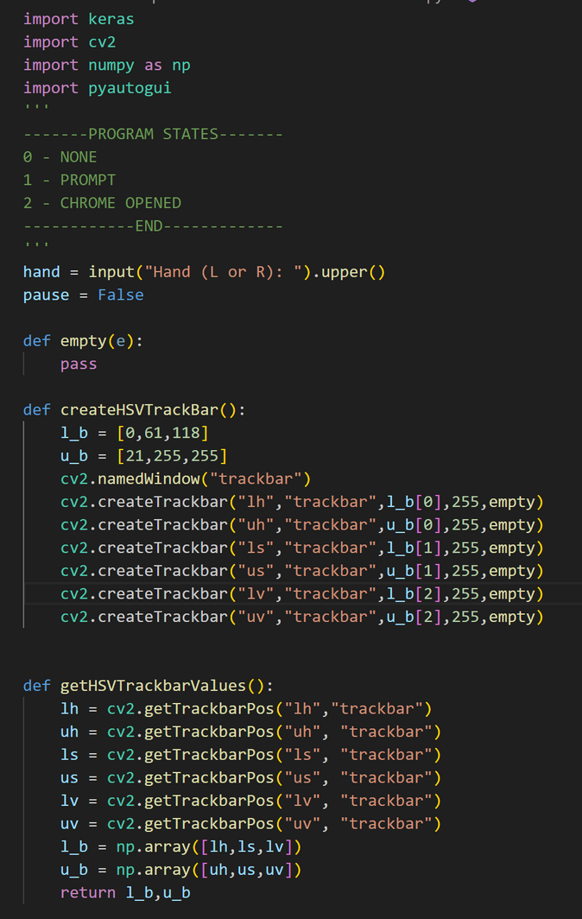
THE CODE
Importing libraries
Asks if you're going to use your left or right hand.
Sets variable pause to False
Creates trackbar to adjust the color settings.
Sets variables to trackbar positions

Slide 6
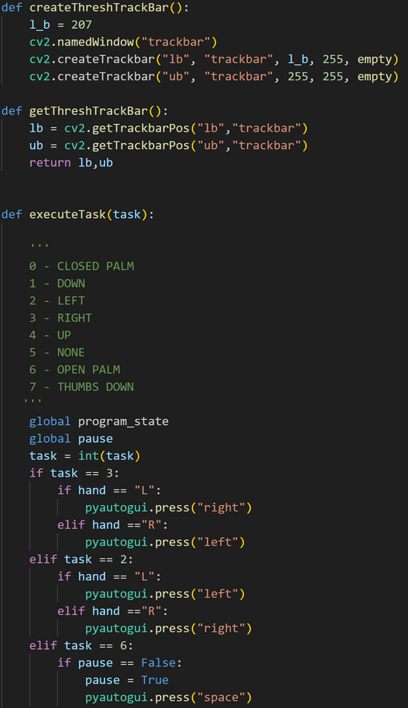
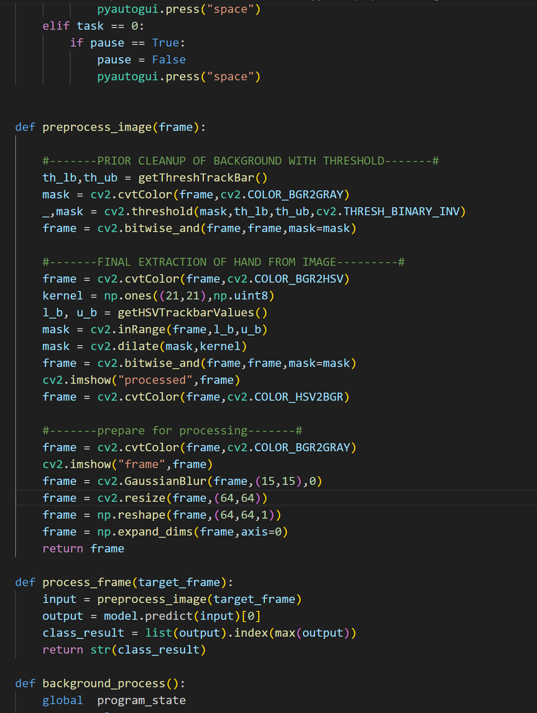
LARANA COMPANY
THE CODE
Creates 2 new trackbars for the background threshold
Sets variables to those trackbars' positions
Detects gestures and presses keys to go back, fast forward, pause, and play
Because pause and play both use the spacebar, a Boolean variable "pause" is used to toggle between the actions

Slide 7
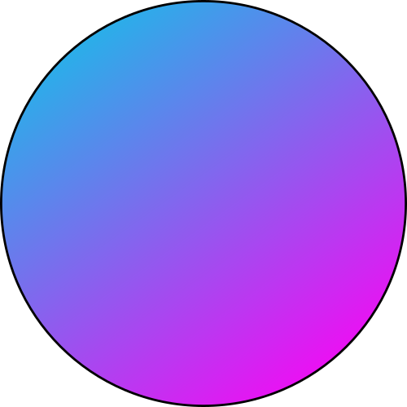
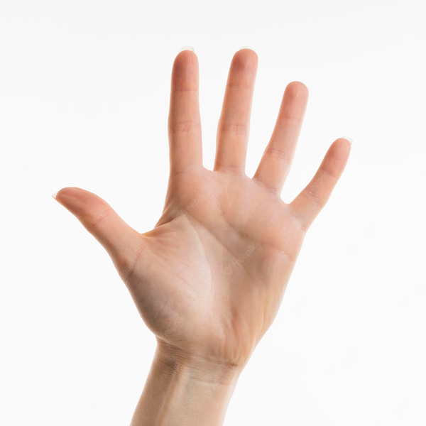
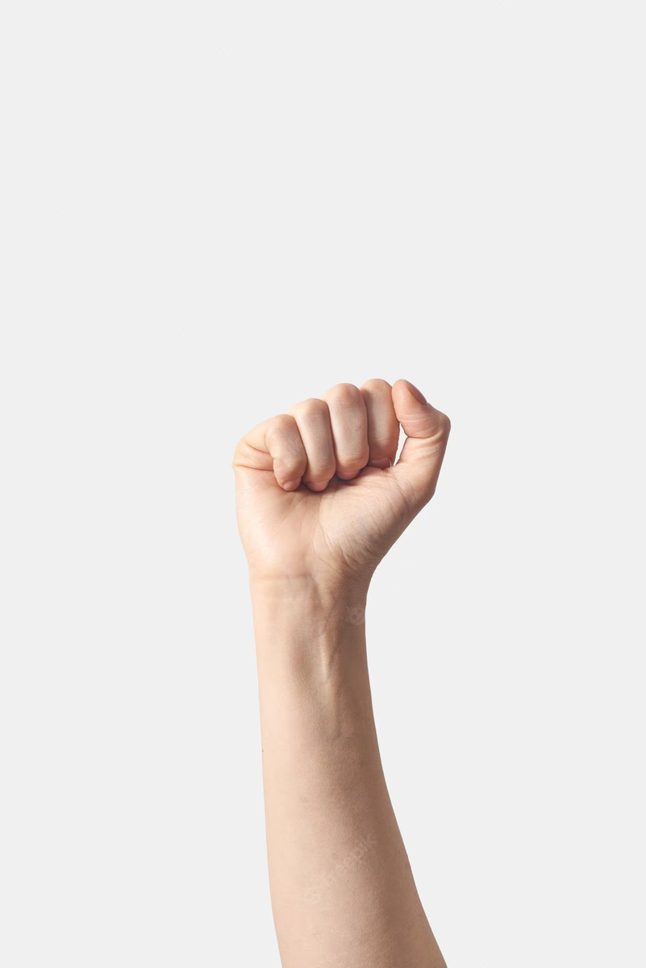
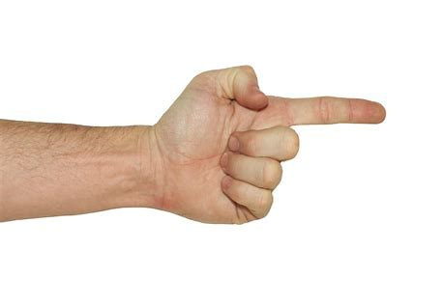
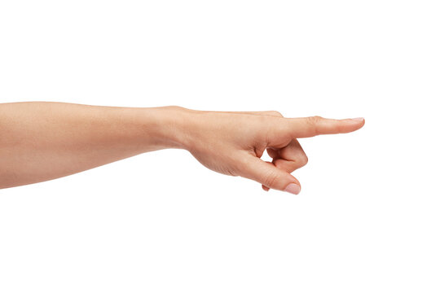
Gestures
Pause
Resume
Fast Forward
Skip Backwards

Slide 8
LARANA COMPANY
THE CODE
Uses the threshold values to clean up the background
Creates a frame for the user to put their hand in
Extracts the hand from the image
Processes the image

Slide 9
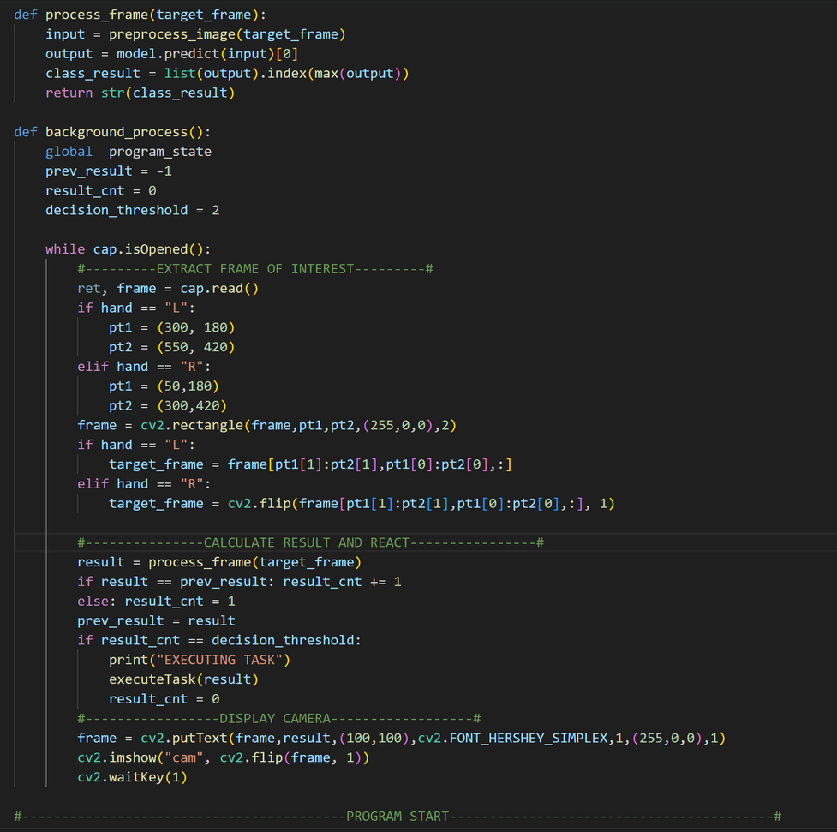
LARANA COMPANY
THE CODE
While the screen capture is opened, it takes the frame
The model detects left hand, so if using your right hand, it flips the image before processing
Processes the image and executes the task
The program only executes a task if it recognizes the same gesture two frames in a row
Displays the camera and processed image

Slide 10
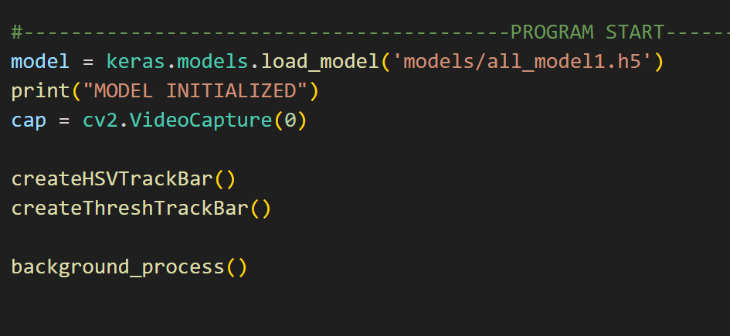
LARANA COMPANY
THE CODE
Loads the model from the project folder
Starts video capture
Runs the createHSVTrackBar(), createThreshTrackBar(), and background_process() functions

Slide 11
THANK
YOU

